Slide 1
CIS 8040 Introduction to Conceptual Modeling Using the Entity-Relationship Model (Chen’s Model)

Slide 2
Important Concepts
The Nature of Data [Revisited]
Data asset – know what this refers to
Different types of useful data; lots of “non-useful” data
Conceptual modeling
What is it?
Where it fits in the entire database design and development process. [After requirements collection/analysis]
Relational databases [This is what we will implement in this course]
Understand what they are (generally, set of tables, called relations)
Where they fit in the entire database design and development process. [After conceptual modeling]
Terminology (Keep these handy. The list only grows ….. )
Data modeling, data models, entity, relationship, attribute, abstraction, instance, instantiation, occurrence, entity type, relationship type, association, mapping ratios, identifiers, key (primary, composite, candidate), mapping ratios, min/max cardinalities, application domain

Slide 3
Database design methodology
Requirements
Collection & Analysis
Requirement collection methods
Requirement specifications
Conceptual
Design
Data modeling methods, e.g. E-R modeling
Conceptual models
Logical
Design
Database Systems (Relational Databases)
Logical models &
Performance requests
Physical
Design
DBMS (Oracle, SQLServer, MySQL,…)
Database Schema
Application
Design
Application development methods
Database Applications

Slide 4
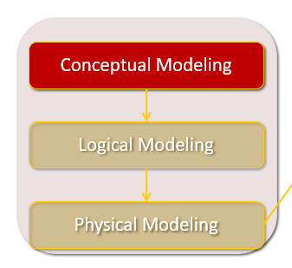
Conceptual Modeling: Creation of ER (Entity-Relationship) Model
Identify entities
Identify relationships with mapping ratios
Add attributes
ER Model
Important terminology:
Mapping ratios [For today]
Min/max cardinalities [Coming – finer level of granularity]

Slide 5
Entity: a “thing” of interest about which you want to record data in a database.
Identify entities
Identify relationships with mappings
Add attributes
ER Model
Person – employee, student, patient, professor
Place – store, university, warehouse
Object – machine, vehicle
Event – sale, registration
Concept – course, account
What do these have in common?
What are the implications for database design?
Note: Can be concrete or conceptual.
Source: Hoffer et al.

Slide 6
Entities
Identify entities
Identify relationships with mappings
Add attributes
ER Model
Suppose you want to design a database for managing student graduation and job acquisition at Georgia State University
Identify 4-6 reasonable entities to include in your database.

Slide 7
Relationship: association between [among] entities
Identify entities
Identify relationships with mappings
Add attributes
ER Model
Examples (of binary relationship):
STUDENT takes CLASS
PROFESSOR teaches CLASS
DEPARTMENT employs PROFESSOR
DIVISION managed by EMPLOYEE
AIRCRAFT flown by CREW
Questions: What do these have in common?
Why would you want to represent these in a database?
How would you represent these in a database? [Later …]

Slide 8
Relationship: operates in both directions
Concept of mappings (reflects real world situation).
Mapping ratios (M:N (or N:M), 1:N (or 1:M), 1:1)
Capture / represent some business rules.
STUDENT takes CLASS
M N
PROFESSOR teaches CLASS
1 N
DEPARTMENT employs PROFESSOR
1 N
DIVISION managed by EMPLOYEE
N 1
AIRCRAFT flown by CREW
N 1
Note: 1:N versus N:1
N:M versus M:N
1:1
Important to be correct
(influences organization of a database)

Slide 9
Relationships: Mappings
Customer buys Car
Chef prepares Menu-Items
Team has Player

Slide 10
Entity and its attributes
Identify entities
Identify relationships with mappings
Add attributes
ER Model
address
email
name
Emp#
dob
EMPLOYEE
Employee: (Emp#, name, address, email, dob)
Attributes are characteristics of entities that are important to include in a database.

Slide 11
Attributes
Domain
Important concept for attributes
Implications for physical design (implementation) where you must specify data type (later)
Domain -- possible values for a given attribute
Domain for grade point average (GPA) [0,4.3]
Domain for answer – T or F (or some other equivalent code).
Attributes may share a domain.
E.g.: student address and professor address share the same
domain of all possible addresses
NOTE: Also the concept of “application domain.”

Slide 12
Entity Student
What are reasonable attributes?
Can you justify them?

Slide 13
Entity and its Attributes
Student: (StudentID, name, address, major, full-time, …)
Context: StudentID at GSU is a Panther#
What other data?
How much do we collect and store? Why?

Slide 14
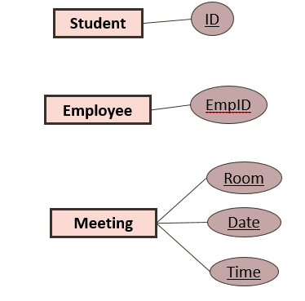
Each entity type must have unique identifier (key)
An entity type may have several qualified keys
Candidate keys
Single key or composite key
Primary key – One of the candidate keys
Primary key attribute(s) is(are) underlined in an entity-relationship diagram
Definition:
Identifier -- one or more attributes that uniquely identify each entity instance

Slide 15
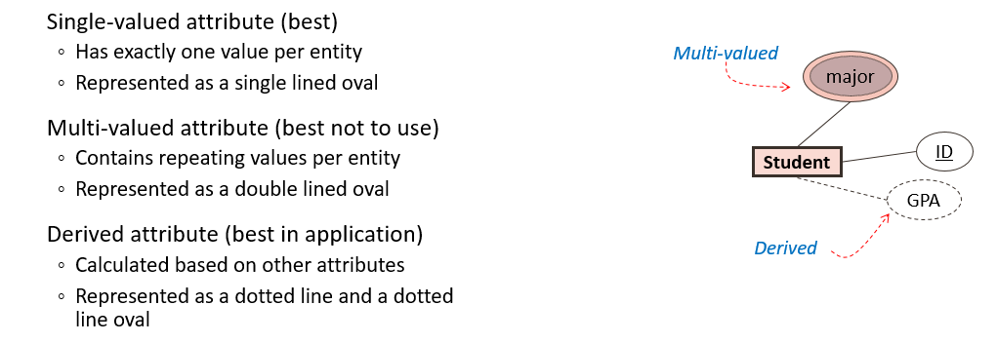
Attribute: single valued, multi-valued, derived
Note: terminology / representation can differ depending on modeling approach used.
This is an entity-relationship model representation.
Multi-values attributes – need to be modeled separate entities. Do not include in your final model.
Derived – obtained in application. Why? Do not include on your final model.

Slide 16
Simple Conceptual Model for Buildings
Identify entities
Identify relationships with mappings
Add attributes
ER Model
location
type
ID
color
NO
size
Building
1
contains
N
Room
Interpretation: A building has 1 to many rooms.
Note: key and non-key attributes.

Slide 17
Example: Symphony Orchestra
You want to develop a database for a symphony orchestra. A concert is conducted by one conductor and includes the performance of one or more compositions.

Slide 18
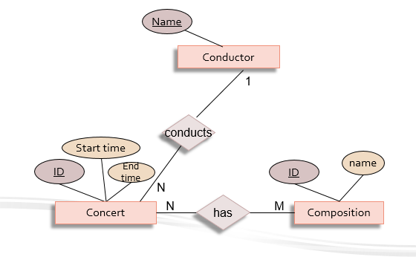
Example: Symphony Orchestra
You want to develop a database for a symphony orchestra. A concert is conducted by one conductor and includes the performance of one or more compositions.

Slide 19
Relationship attributes
grade
Student
N
takes
M
Class
Interpretation?
Note: Only many-to-many relationships can have relationship attributes.
Some exceptions (but not for this course).

Slide 20
Example: Student-Advisor
Each semester, every student is assigned an advisor who helps the student understand degree requirements and register for classes. The advisor can change depending upon the semester. A database is needed to keep track of the students and their advisors for each semester.
Draw the conceptual model (entity-relationship model) for this application.
Identify the entities, relationship, mappings (mapping ratios), attributes

Slide 21
Example: Roger’s Catering Service Each dinner is based on a single entree, but each entree can be served at many dinners. A guest can attend many dinners. Each dinner can be attended by many guests. Each dinner invitation can be mailed to many guests, and each guest can receive many invitations. Develop a conceptual model for this application.
Identify entities
Identify relationships
Identify attributes (based on your own knowledge)

Slide 22
Conclusion
Conceptual modeling – important phase of database design
Entity-relationship model
Entities
Attributes
Relationships
Important notion of keys
Entities have keys. Must have primary keys (may be composite).
Relationships are associations among entities but do not, by themselves, have keys.
Examples
Capture essence of what is important in the real world
(e.g., attributes to include in a student database)
Important to identify correct mapping ratio. Why?

